Slide 1

Combining DDD and BDD to boost acceptance Testing and testing automation ^{Leonardo Souza Mattos} ^{#TAS19}
Philadelphia
April 5th, 2019

Slide 2


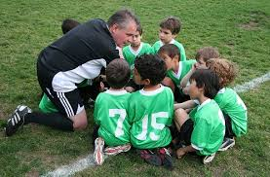


About me
Technical Coach
Developer
Soccer coach
Adventurer
IT Services
Principal Consultant
20+ years
In the industry
Licensed for kids
U10 - U16
16 personalities test

Slide 3
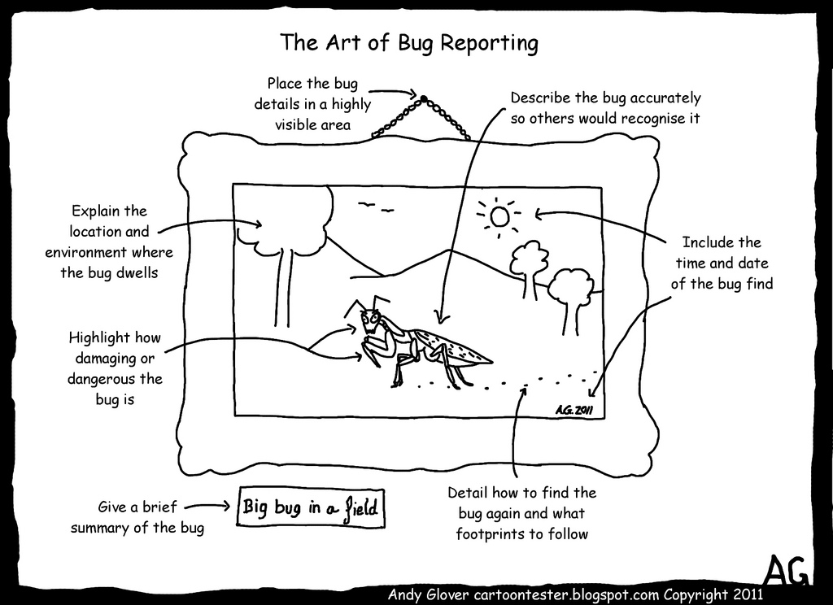
Have you heard this before?
“I tested it how you told me to”
“Acceptance criteria said this is expected”
”When you say ‘account’, you want to mean ‘client’, right?”
“I assumed it was fine”
”I have not tested with this input. I didn’t know it could happen”
“ I didn’t know what to test”
Notes:
Tell my personal story about transforming from Java application / migrating legacy app to Cloud :
I was hired as a consultant to redesign the application and their tests ( they had just a big Regression testing pack ) to a move it to Cloud, increasing the CD and all. I needed to understand what is the problem that application was trying to solve. What its the domain and all. So then I first went to see some documentation, obviously. And what I found? Besides that just a small part of the application was documented, they were not updated and the only thing I saw there were somehow technical : tech design, info about how to run the app and tests, how its deployed and so on. Nothing would tell me what the application does. Then, obviously, I went to validate their regression testing pack. am trying to understand their application behavior, the test cases they have

Slide 4

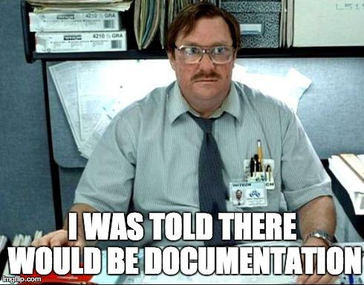
Notes:
One of the biggest challenges as engineers is to write working software and also keep an extensive documentation. Most engineers hate writing documentation, and after they published documentation on a wiki it will die a lonely death. We want to strive for writing a Living Documentation in an Ubiquitous Language. Practices like Domain Driven Design (DDD) and Behaviour Driven Development (BDD) can help you achieve this. Especially when we start writing code, it is really important for the quality of our software to start with tests describing what your application does. We want to write software with empathy in mind, software that is understandable for peers. While software developers are beginning to use the language of the domain (business language) more in their application code, most tests still contain a lot of technical language.

Slide 5
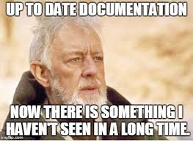
Have you seeing this before?

Slide 6
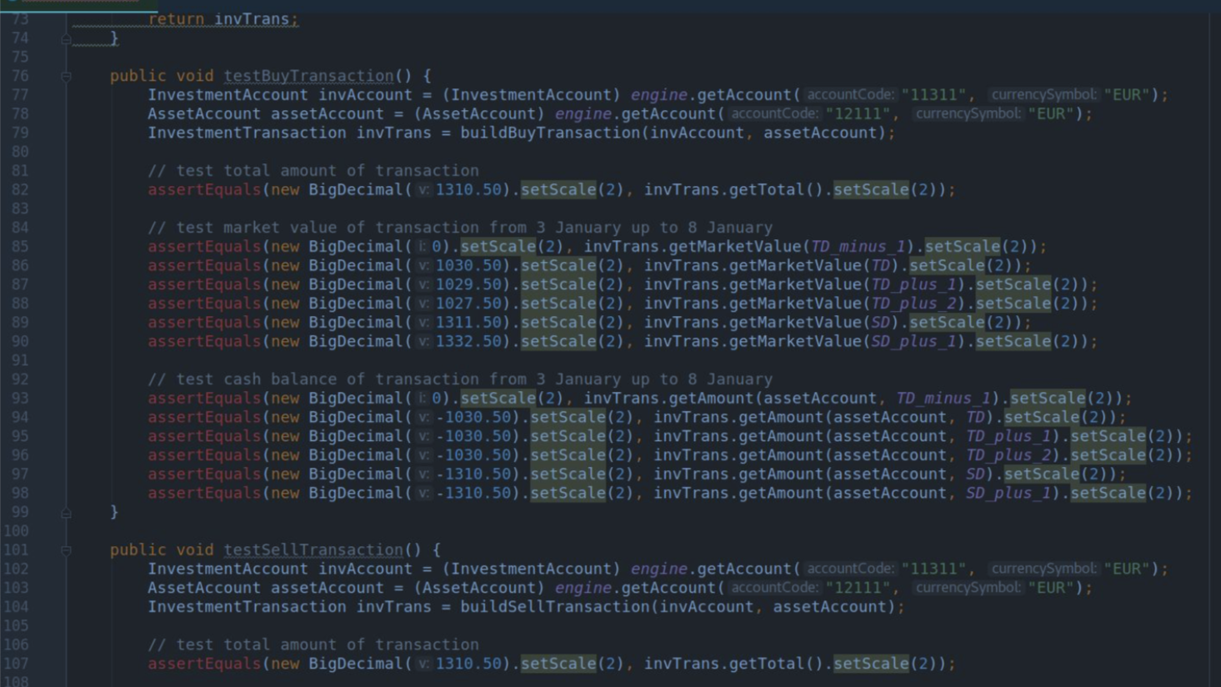
Notes:
Story : “here you can see the development was not done with TDD in mind. TDD is a mechanism that maes you design testable, your code testable and you tell through tests what you expect that application do or behaves.”
As software developers we have all been there: the moment you pull in a new project and you start with trying to figure out what it does. You start figuring out how the design works and eventually you want to know what a piece of software really does, so you open up the unit test and find something like the following test code functions:
[code language=”java”] public void testReservation() public void should_reserve() public void buildReservation() [/code]
It might be even worse, a critical software bug was reported, and you try to figure out where the bug came from. Tests like the one in the example do not tell you how the code should behave, it does not match the language the bug is reported in. Getting insights into what went wrong takes a lot of language/context switching and translating, which is time consuming and a waste of time.
You as experience testers can tell me, what would have helped in this situation? Please should on aspect.
What would have helped in this situation is that the tests are written in such a way that they tell you how the code should behave in the domain language. This way the model that the bug is reported in, and the tests and code have the same language and model.

Slide 7
What was wrong with that?
Tests weren’t saying what the application does
Created by developers, potentially after the code was done
If fails doesn’t tell me nothing. Need to go through the code to figure out something.

Slide 8

Is this TDD?
What is the domain?

Slide 9

[code language=”text”]
Scenario: Redirect user to originally requested page after logging in
Given a User "dave" exists with password "secret” And I am not logged in
When I navigate to the home page Then I am redirected to the login form
When I fill in "Username" with "dave" And I fill in "Password" with "secret" And I press "Login" Then I should be on the home page
[/code]
Notes:
Story : “But wait a minute!! This team had automated Regression testing, that needs to come from some sort of acceptance tests. I know they use Fitnesse and Selenium to write the tests, so, they for sure tell me how the application works. Nahn!!”

Slide 10
What was wrong with that?
Misunderstood BDD : just because its Gherkin does not mean its BDD
Design driven by the tool
Use the “new thing” without knowing how it really works.
Notes:
The same example usually applies to acceptance tests. In most cases these are still being owned by the testers, which in my opinion is a strange behaviour because the only one capable of breaking them are actually software developers. If you are lucky enough that the acceptance test are owned by the developers, you can start with crunching some domain knowledge trough these tests. Then you open up the tests only to find the following:
[code language=”text”] Scenario: Redirect user to originally requested page after logging in Given a User "dave" exists with password "secret" And I am not logged in When I navigate to the home page Then I am redirected to the login form When I fill in "Username" with "dave" And I fill in "Password" with "secret" And I press "Login" Then I should be on the home page [/code]
This is what we call the implementation pitfall. It is when software developers use a tool out of his or her context, in this case usually Cucumber. Reading this does not give you information about the behaviour of the system, only about how the behaviour is implemented. Of course it is better than no acceptance tests, but think about the consequences of this action. Usually the behaviour of a system does not change, there will only be new behaviour, or behaviour will be removed. The implementation details of the system is the only factor that changes. Every time this happens, we do not only need to change the system, but also the feature files and test code. As developers, we learn to create low coupling system, describing features as implementation in Gherkin files is high coupling, and something we really do not want! Besides, as a software developer I want the documentation to match the model and the language of the domain, which should not be the implementation!

Slide 11
What is the story?
What is the expected behavior?

Slide 12

What is the solution?

Slide 13

Domain language throughout tests, combining DDD and BDD
Its all about story:
DDD is about empathy. Its about knowing each other , knowing the model.
BDD is all about story and what is the story of what we are building.
Notes:
Science has proven that we learn and we improve by failing and experimenting. Examples are there everywhere in some sort of science. Including Continues Delivery. Examples on sciency are the special programs and the space run, and the boil temperature of the water for instance.
Focus now will be on tests. As the functional development is already there, improved with DDD and BDD, but the tests are little behind.

Slide 14
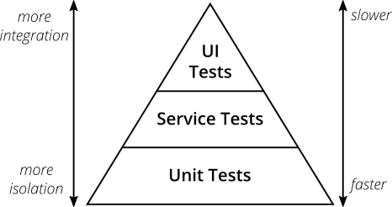
There are many testing pyramids
Notes:
Test pyramid misses the ( not useful map ). 3 important feedback loops : ideas, executable spec and unit tests.

Slide 15
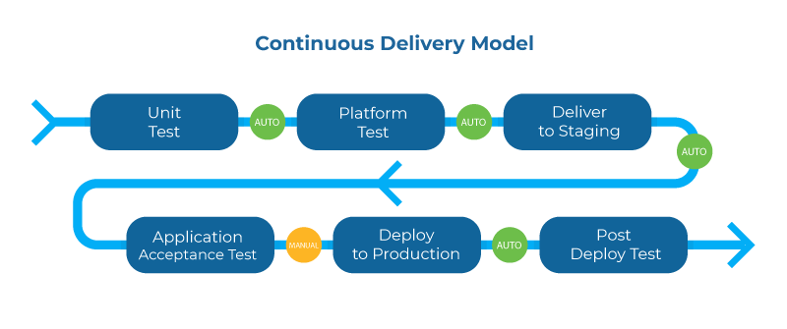
Testing pyramids are not a good map

Slide 16
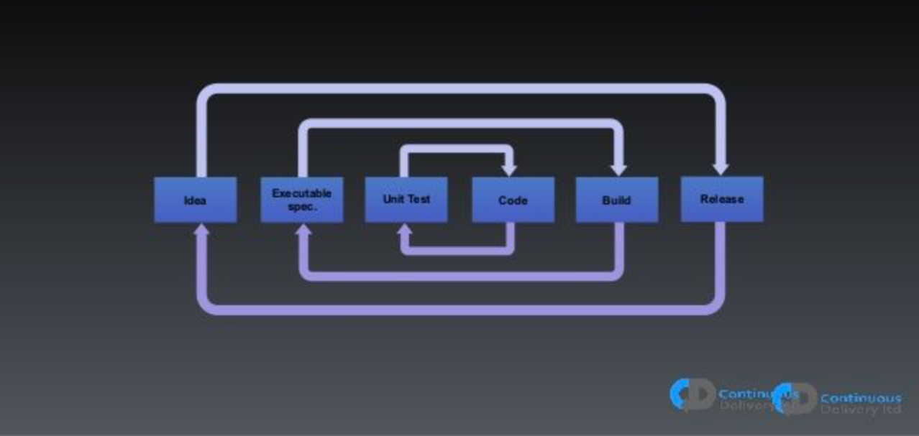
Feedback loops
Notes:
Important feedback loops
Ideas : validate ideas or initiates are good - A/B testing
Unit : I want to fail fast. Are the fastest test to be run
Acceptance : are my executable specs.

Slide 17
Navigation by public transport
As a commuter
I want to know the fastest route between two places,
In order to get to my destination as quickly as possible
Notes:
Science has proven that we learn and we improve by failing and experimenting. Examples are there everywhere in some sort of science. Including Continues Delivery. Examples on sciency are the special programs and the space run, and the boil temperature of the water for instance.
Focus now will be on tests. As the functional development is already there, improved with DDD and BDD, but the tests are little behind.

Slide 18
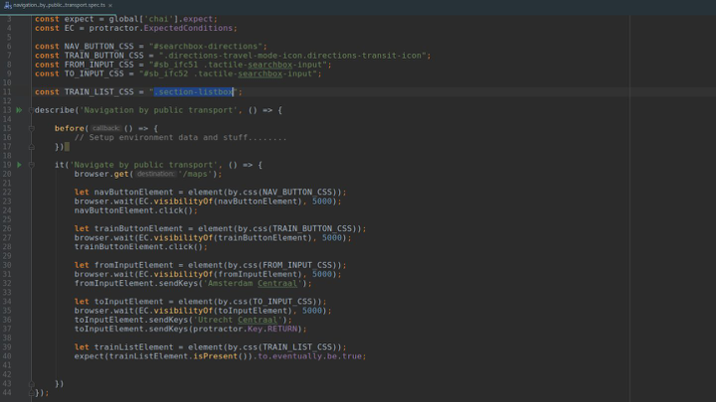
Notes:
This is webdriver. You can talk to it and it will click on your UI and you can select the browser. Its type script generated by a recorder tool with some changes.
First issue with it : if you don’t know the language you are screwed.
Second : you don’t know what its going on
What you see its people writing in Ghurken with Cucumber

Slide 19
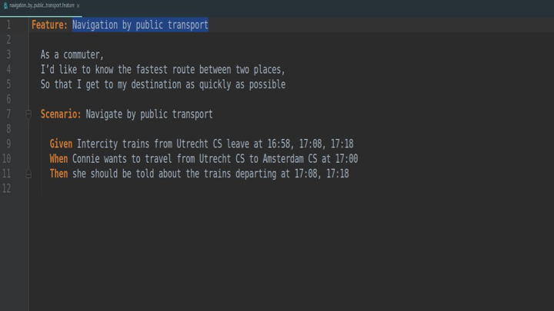
Notes:
This is a little bit better…. You have at least the intention. But you still don’t know the flow of the application. What is the implementation? Where the issue is? I want to have something more. I want to see the flow!!!

Slide 20
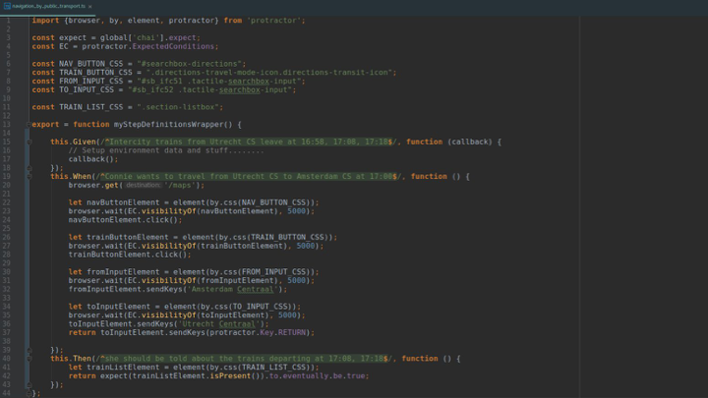

Slide 21
DDD + BDD in practice: Feature Mapping!!
Notes:
BDD -> who owns the feature files? I see that Dev do all and then throw to QA that send back : on my machine works.
BDD needs to be done with all the team.. Testers embedded creating the acceptance test.
How we do it? We will see now.
John Smart done feature mapping.

Slide 22

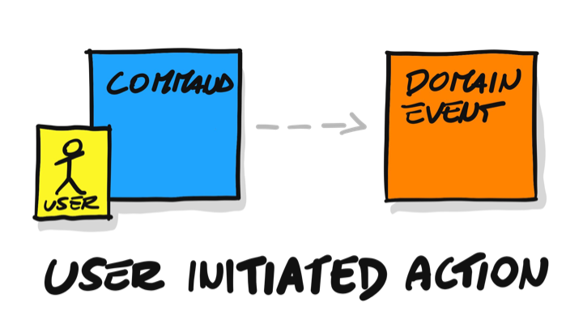
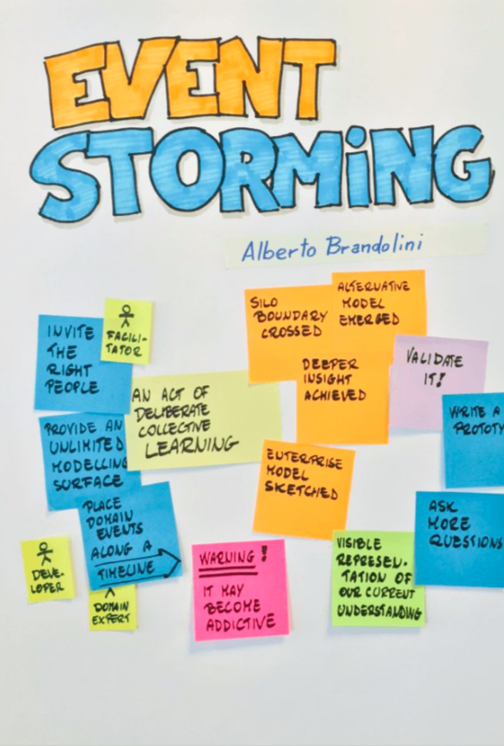
How feature mapping helps on acceptance testing
This technique is all about creating specification based on examples, communicating human language what the software does. It’s a map on how is the flow of feature implementation
Event storming and Examples and Rules, through making the ”Spec by Example” embedded on your testing code
Notes:
Event Storming
Now for step 3 it is time to start Event Storming. Event Storming has five important concepts:
Command (Blue): Decision or action. Aggregate (Yellow): Local Logic Event (Orange): Domain Event Policy (Lilac): Reactive Logic (Whenever), Listener, Process Manager, Saga. Read Model (Green): Key Information
The basic Event Storm flow is: Command -> Aggregate -> Event -> Read Model or Policy.
If you want to know more about these concepts, I would recommend you to read the book about Event Storming or attend a Workshop Event Storming. I will not go into too much detail about Event Storming, but just enough for you to follow along.
So we start to Event Storm a naive flow for ordering movie tickets without defining the Aggregate yet. First, write down the outcome as an Event and try working from the start of the flow towards that event.
The most important part about this is that any discussion needs to be visualized, either by Event Storming or just by drawing pictures. When we are Event Storming, we usually start by giving examples. These examples should be written on a green sticky note and be placed on the left side of your Event Storming. We can start giving our Aggregates a name. It can happen that multiple models already start emerging here; put them beneath or next to the other one.
Examples and Rules
The next step is step 4; for now, we will use Example Mapping to keep it simple. The aim is to get as many examples as possible. If you want to go deeper and create a Feature Map that would be the best! You can read more about going deeper at the post about Feature Mapping.
When we are done, we want to pick out one or two rules with the scenarios that are most important and leave the other ones only in the back of our minds. It is time to go back to our Event Storm and check if our model is good enough to run the examples through. At this point, multiple branches and flows will start to emerge. This gives you the opportunity to see your model from different angles and create other models. You will probably see the same Aggregates in the same flow. The time has come to let go of the flow and start building towards modeling our Aggregates trough state-machines.

Slide 23
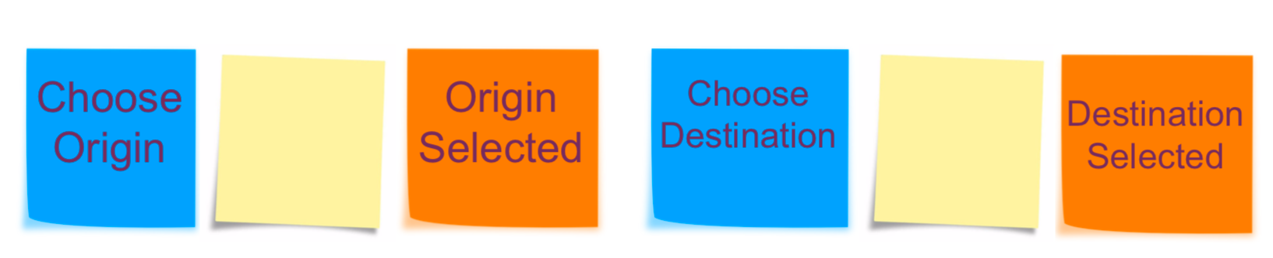
Event storming
Event Storming is a form of organizational anthropology; it’s all about discussing the flow of events in your organization and modelling that flow in an easy to understand way.

Slide 24
Event flow
A single event isn’t very exciting, so we need to consider events in term of flow — events over time. Orange stickies represent events. To model a business process we simply arrange events from left-to-right in time sequence. That’s it! Sounds simple? It is. That’s the point. There’s no unnecessary ceremony between you, your team, and an interesting discussion that yields results.

Slide 25
Reaction
A reaction is something that needs to happen after something else happens. Reactions are best captured in the following statement,
“This happens whenever that happens”. This is the reaction. That is the event. Whenever is the word that associates an event to a reaction to create a policy.
Notes:
A reaction is something that needs to happen after something else happens. Reactions are best captured in the following statement,
“This happens whenever that happens”. This is the reaction. That is the event. Whenever is the word that associates an event to a reaction to create a policy.
If you find yourself using the term whenever to describe a sequence of events, you’re speaking in terms of a event-driven system. The order of these statements is less important than the contents of the statement.
“Whenever a new user account is created we will send her an acknowledgement by email”.If you read the above statement, the key is in the tense. Events are always past-tense, while reactions are always future-tense. More importantly, we never discuss “now” — we can’t make any assumptions about the current state of a system, because there’s no guarantee that what we intend to happen will actually happen. Mistaken assumptions are the root cause of most failures in computer systems. By modelling only cause-and-effect, we can better decide how to react to anything, because we’re not making false assumptions about outcomes — not only successful outcomes, but also errors and other less-than-ideal events.

Slide 26
Policy
The flow of events and reactions together is called a policy — we call this flow a policy because the flow captures core business rules, such as “we need to alert a customer whenever someone logs into their account”.
It’s also important to note that a reaction — or an entire policy — doesn’t need to represent a piece of software. For instance, “confirm payment details” may be a manual process that involves an administrator manually verifying wire transfer details.

Slide 27
Command
Eventually we need to dive deeper and map out exactly how users interact with our system; commands are critical because they often represent user interactions. Adding user interactions to our event flow brings us towards modelling the complete cause-and-effect of our system.
Notes:
In the example, we can visualize that a credit application was submitted by a user and eventually causes an approval or rejection decision. As we continue to model this business flow, we’ll eventually make our way to even more detailed elements that help to capture:
User interface requirements
Data models
Etc
Keen observers will also notice that commands are very similar to reactions. The only difference between commands and reactions is that commands are often initiated by users, while reactions are often initiated by events. It’s helpful for your team to agree on how to discuss the nuances of commands and reactions right from the beginning — for example, some teams use reactions purely to document more complex processes, and use commands for both system and user actions. It’s completely acceptable to tailor the way your team uses various elements of event storming to meet your own needs, as long as your team crafts a legend that everyone follows.

Slide 28
In our example

Slide 29
Example Mapping
This comes from Cucumber, from BDD
Discovery phase. Flipping out examples
Domain experts needs to be in the room
Get 4 coloured cards
Don’t think initially on Gerkhin. Goes like “friends episode names” : “The one when”
If there is discussion or questions, you park on pink cards if cannot be solved in 15 min or no experts
Notes:
Concrete examples are a tremendous way to help us explore the problem domain, and they make a great basis for our acceptance tests. But as we discuss these examples, there are other things coming out in the conversation that deserve to be captured too:
rules that summarise a bunch of examples, or express other agreed constraints about the scope of the story.
questions about scenarios where nobody in the conversations knows what the right outcome is. Or assumptions we're making in order to progress.
new user stories we discovered or sliced and deferred out of scope.
Example Mapping uses a pack of four coloured index cards and some pens to capture these different types of information as the conversation unfolds. As we talk, we capture them on index cards, and arrange them in a map:

Slide 30
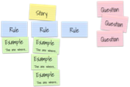
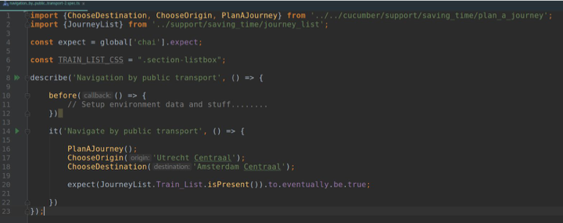

Slide 31
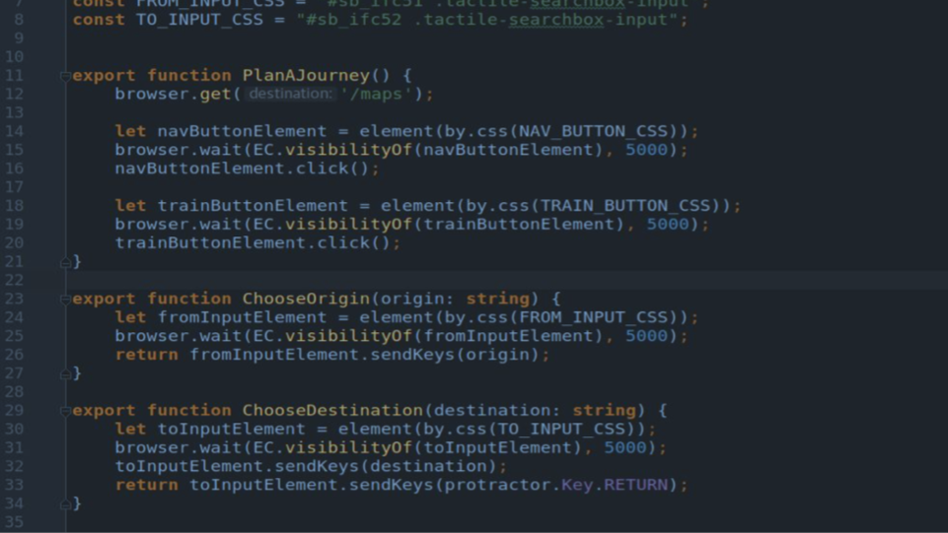
WebDriver

Slide 32
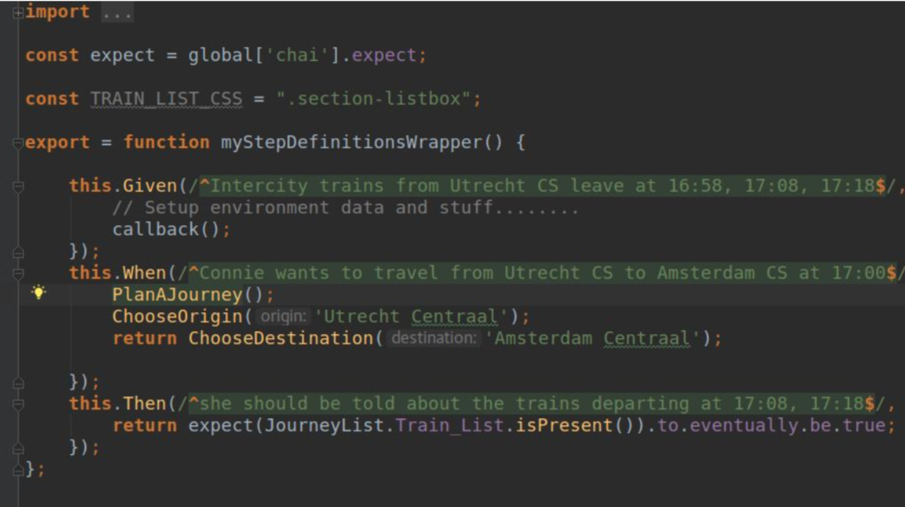
Cucumber

Slide 33
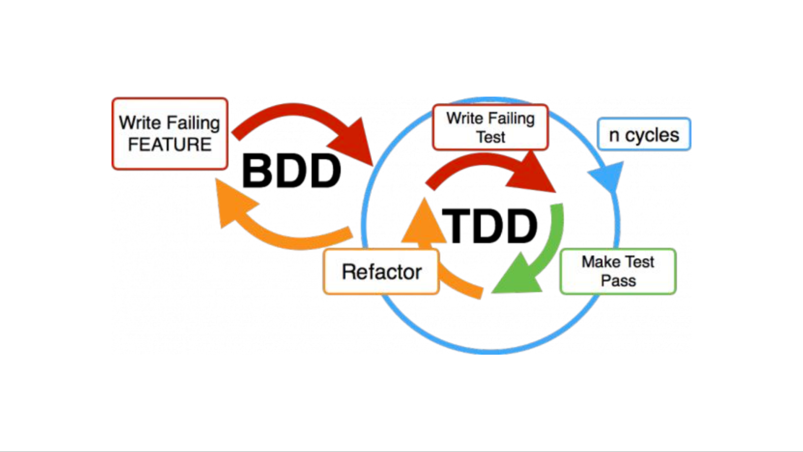
Conclusion
Enhance your acceptance testing with executable spec by example ( they can be written in Excel, Cucumber, Fitnesse, JSON files, etc…
Empathy from DDD + Story from BDD + Science = Better testing via quicker feedback ( Your CD thanks you )
It can and should be done from all test levels
Notes:
Additional thinks:
The model and ubiquous language needs to flow throught the app and tests for everyone talk the same terms
Communication

Slide 34
Questions?

